Slide 1

Task Management
GUSTAVO FLEURY SOARES
October / 2018
Notes:
As próximas visitas serão compostas por 2 consultores;

Slide 2
AGENDA
1
The Problem
3
The Task Management
2
Existing Solutions

Slide 3

PROBLEM – A lot of TASKS

Slide 4

PROBLEM – A lot of TASKS

Slide 5
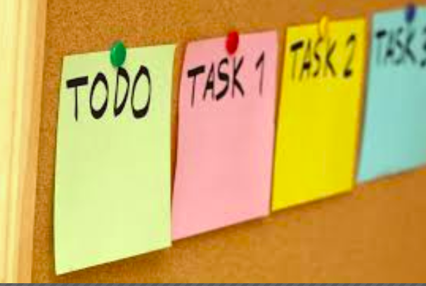
Existing Solutions - Sticks

Slide 6
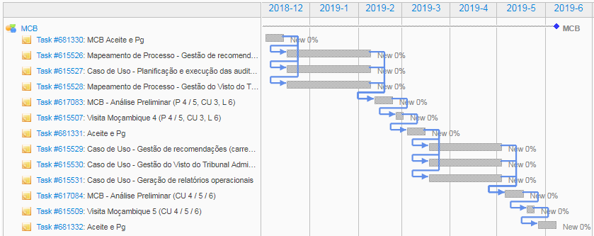
Existing Solution – “Projects”

Slide 7
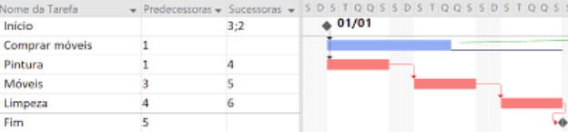

Problem: Estimated Data/ Cost

Slide 8

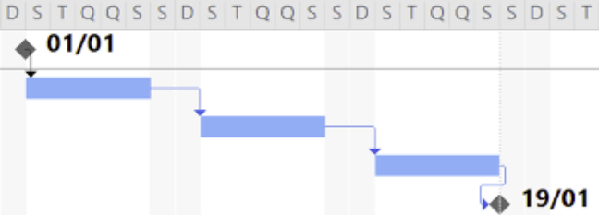
The Task Management
Database +
Statistics
Better Estimation

Slide 9
Thank you!
Questions?

